Slide 1
Environmental Management Plan (EMP)
Unit - III

Slide 2
Introduction
It is a document outlining measures to prevent, minimize, and mitigate a project's negative environmental impacts and
Ensures sustainable development, regulatory compliance, and environmental protection through integrated management, monitoring, and mitigation strategies during all project phases (construction, operation).
It sets standards for pollution control, waste management, green spaces, and worker health, aligning economic goals with ecological responsibility.

Slide 3
Intro – Contd…
Environmental Management Plan (EMP) is a systematic plan prepared after EIA.
It explains how environmental impacts will be managed and reduced.
EMP converts EIA recommendations into practical actions.
It ensures environmental protection during project execution
EMP supports sustainable development
EMP helps in reducing negative environmental impacts

Slide 4
Purpose:
To identify and manage potential environmental impacts, ensuring development is sustainable and compliant with laws.
To protect the environment during the project
To reduce pollution caused by project activities
To control environmental impacts on air, water, land, and noise
To implement EIA recommendations in practice
To follow environmental rules and regulations
To monitor and manage environmental performance

Slide 5
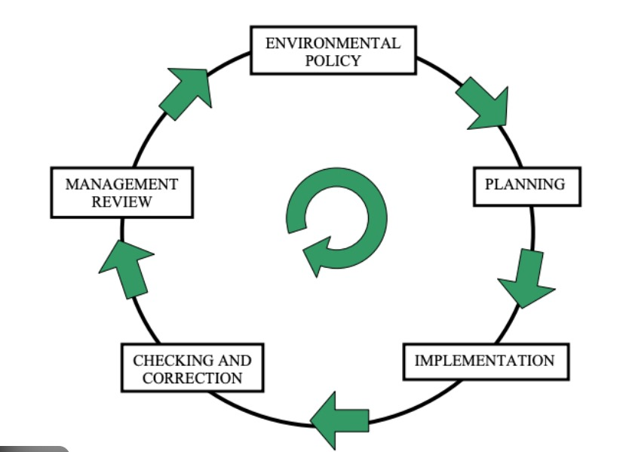
Purpose of EMP:

Slide 6
Objectives:
Pollution prevention (air, water, waste, noise), compliance with environmental laws, ensuring worker safety, and integrating environmental costs into planning.
To protect the environment during the project
To reduce pollution from project activities
To control harmful impacts on air, water, land, and noise
To follow environmental rules and laws
To manage waste properly
To monitor environmental conditions regularly

Slide 7
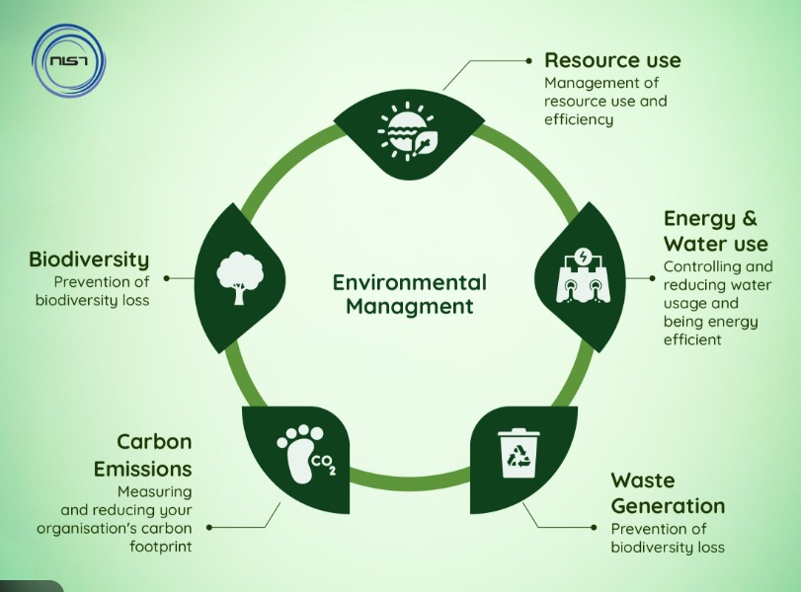
Importance of EMP

Slide 8
Importance of EMP
Helps in preventing environmental damage
Ensures safe and healthy surroundings for people
Supports sustainable development
Reduces environmental risks and accidents
Improves project acceptance by society
Helps in smooth project operation

Slide 9
Elements of EMP
Key Elements include
Clear objectives,
Defined responsibilities,
Operational controls (like waste hierarchy),
Training, emergency procedures, and
Continuous monitoring & review for improvement
Identification of Environmental Impacts
Mitigation Measures
Monitoring Plan
Institutional Responsibilities
Implementation Schedule & Budget
Reporting, Review, and Corrective Action

Slide 10
Elements of EMP
1. Identification of Environmental Impacts
Identify and summarize significant adverse and beneficial impacts predicted in the EIA.
Covers impacts on air, water, land, ecology, noise, and socio-economic environment.
2. Mitigation Measures
Specify measures to avoid, minimize, or compensate for adverse impacts.
Includes engineering controls, operational practices, and ecological restoration.
3. Monitoring Plan
Defines what, where, how, and how often monitoring is done
Ensures mitigation measures are effective
Includes standards/limits and corrective actions if limits are exceeded

Slide 11
4. Institutional Responsibilities
Assigns roles and responsibilities for EMP implementation
Identifies project proponent, contractors, environmental officers, and authorities
Establishes reporting and supervision mechanisms
5. Implementation Schedule & Budget
Timeline for mitigation and monitoring activities
Cost estimates for each EMP activity
Ensures availability of financial and human resources
6. Review, Reporting & Corrective Action
Regular reporting of monitoring results
Periodic review and environmental audits
Modifications to EMP based on monitoring feedback and project change

Slide 12
Preparation of EMP
It involves in systematic identifying a project's environmental impacts, defining mitigation measures, establishing monitoring protocols, and assigning responsibilities to ensure compliance with laws and promote sustainable development.
Key Aspects of EMP:
aspects like air/water quality, waste, noise, and emergency response for construction and operational phases

Slide 13
Key Steps in EMP Preparation
Context & Policy:
Understand the project's scope and legal obligations (e.g., air/water acts).
Develop an environmental policy and secure leadership commitment
.
Define roles, responsibilities, and establish an EMS team.
Impact Assessment:
Identify environmental aspects (emissions, waste, resource use) and related impacts (air/water pollution, noise, habitat disruption).
Analyze baseline environmental conditions and sensitive areas.
Assess potential risks and accidents.
Mitigation & Control:
Develop specific mitigation measures for pollution (air, water, noise, waste) at the source.
Plan for resource management, green belt development, and waste disposal.
Outline operational controls and safe work practices.
Monitoring & Reporting:
Establish a monitoring system for key parameters (air quality, water, noise, emissions).
Include Quality Assurance/Quality Control (QA/QC) for monitoring.
Define data management, reporting protocols, and communication plans.
Emergency Preparedness:
Develop emergency response procedures for accidents (spills, fires, chemical releases).
Conduct mock drills and ensure staff training.

